Slide 1
Project 3 Visualization Track Presentation
Chris Kellam, Eric Lidiak, Jason Britton, Matthew Smith, Molly Fox

Slide 2
Project Summary
TOPIC: Public Demonstrations Post Covid
DESCRIPTION
Create a dashboard to visualize various categories of public demonstrations in the post-COVID United States.
RESEARCH QUESTIONS
What types of public demonstration events have occurred post-COVID in the US?
When are these events occurring?
Where are these events occurring?
What portion of the events were peaceful?
How many fatalities were there?

Slide 3
Data and Delivery
Datasets
ACLED (Armed Conflict Location and Event Data): acleddata.com
States Data: https://leafletjs.com/examples/choropleth/
The dashboard utilizes information from a SQL database created from the original comma delimited dataset download subsequent to ETL.
This process utilized a PostgreSQL adapter Python library called "Psycopg".

Slide 4
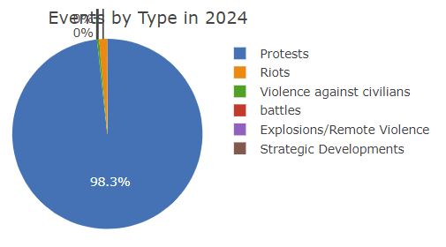
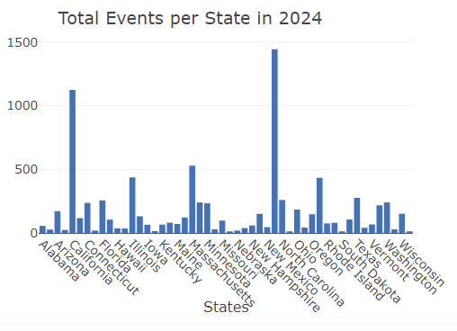
Visualizations
Event Types Distribution
Total Events by State

Slide 5
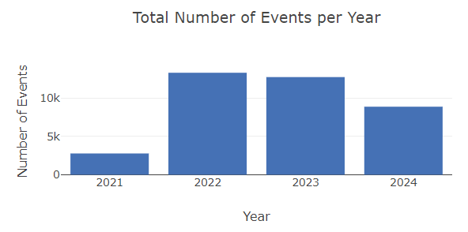
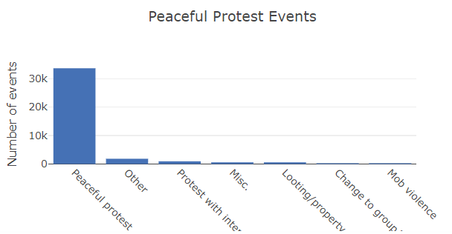
Visualizations
Events Per Year
Peaceful Protests

Slide 6
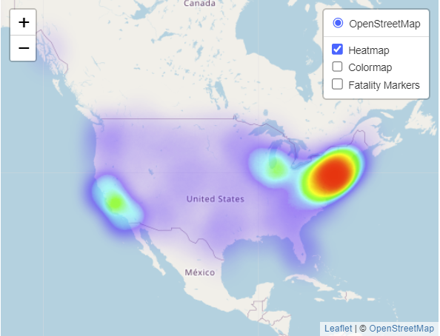
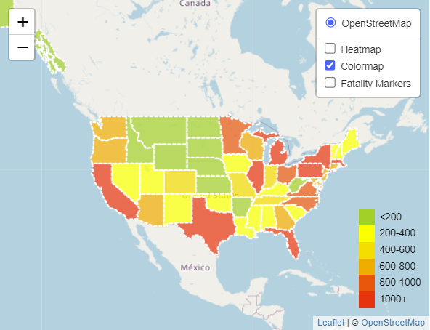
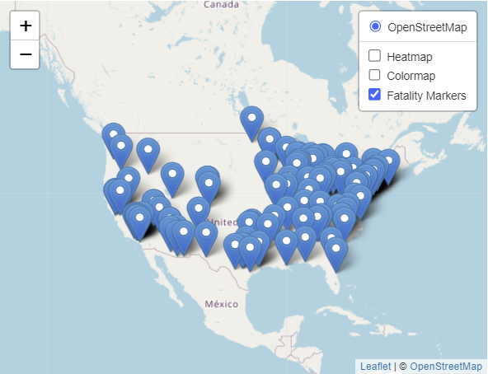
Visualizations
Heatmap Layer
Colormap Layer
Marker Layer

Slide 7
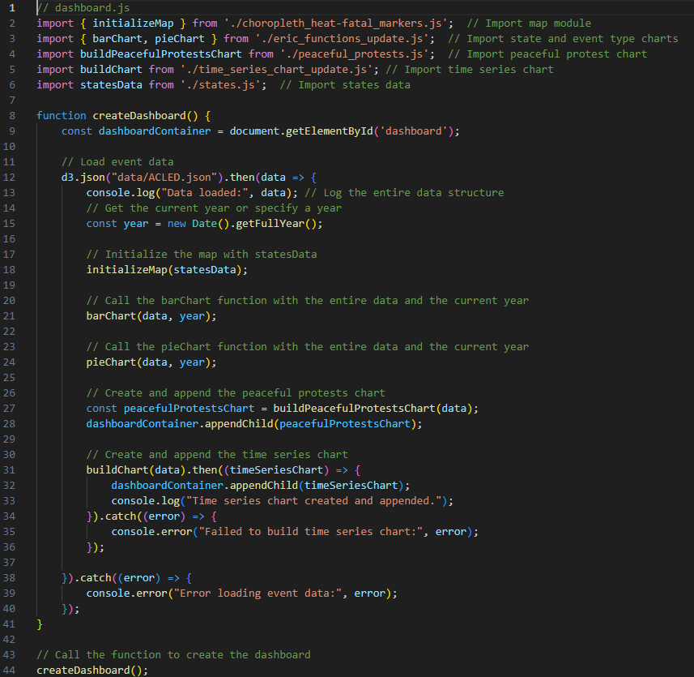
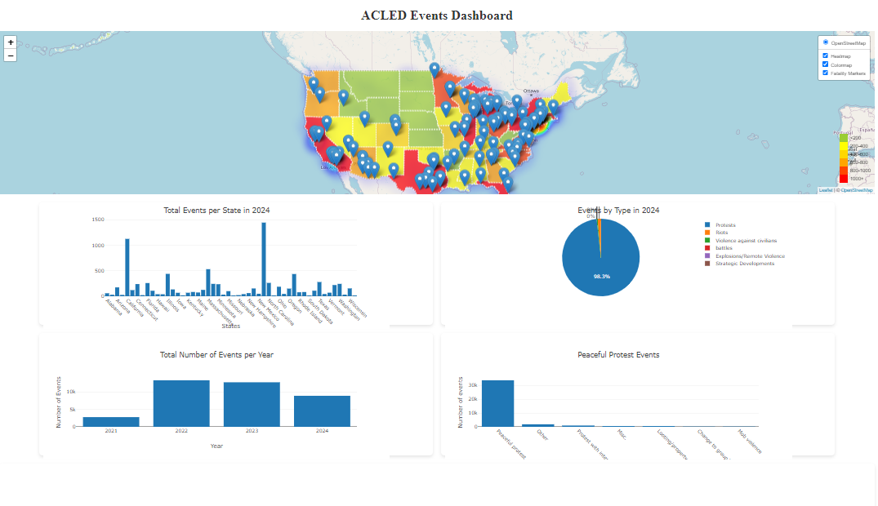
Dashboard
https://jcbritton.github.io/Project3/

Slide 8
Ethical Considerations
Sourcing and Bias
Where is ACLED’s data coming from, and is it accurate?
Data sources: traditional media, international organizations, NGOs, local partners, social media (Twitter, Telegram, WhatsApp).
Potential challenges: underreporting in certain areas, mischaracterization of events, political bias in reporting.
Review Process
ACLED claims the data is accurate, comprehensive, and regularly updated.
Data collection and review are human processes, prone to explicit or implicit bias.
Are judgments about categorization and inclusion made objectively?
Privacy and Data Use
Are individuals in reported events, especially in sensitive contexts, at risk?
Is informed consent being obtained where necessary?
Could the data be misused to support harmful policies or action?

Slide 9
Key Observations
Protests are the primary public demonstration type
California and New York have the highest number of demonstrations
Demonstrations have been declining slightly since COVID
The number of peaceful protests is far greater than non-peaceful
Public demonstrations increase around populated areas
Coastal states tend to have a higher number of demonstrations
Fatalities tend to cluster around states with 600+ demonstrations

Slide 10
Thank You

